Slide 1


Java Workshop

Slide 2
Goals for today
We will be really exercise-based, so you get actual experience and get used to using Java + Eclipse
I will be making a lot of references to C (APSC 160 + CPSC 59), so you can see what existing knowledge you have and how that will apply to Java
By the end, hopefully you should:
Have an understanding of the strengths of weakness of Java compared to other programming languages
Be able to use Java to accomplish anything you were already able to in C
Know some principles of Object Oriented design
Given a problem, be able to think of some strategy or way to simulate in in Java

Slide 3
Why should you learn Java?

Slide 4
Comparison of Languages
C | Python | Java
Lower Level (Generally faster) | Concise & Simple | Type-safe & Secure
Good for programming fundamentals | Dynamic typing* | Used in Android development
 | Extremely popular | Extremely popular
Manual memory management | More potential runtime errors* | Verbose
No built-in object oriented support

Slide 5
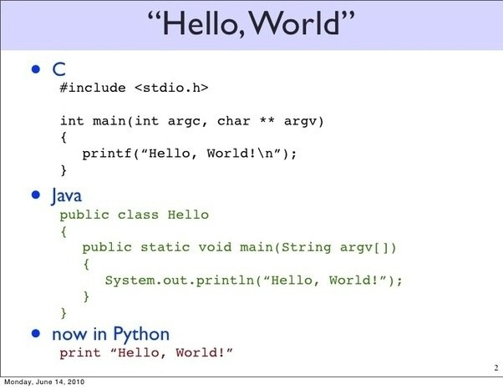
Comparison of print statements

Slide 6

Popularity of Languages on Github for 2017

Slide 7
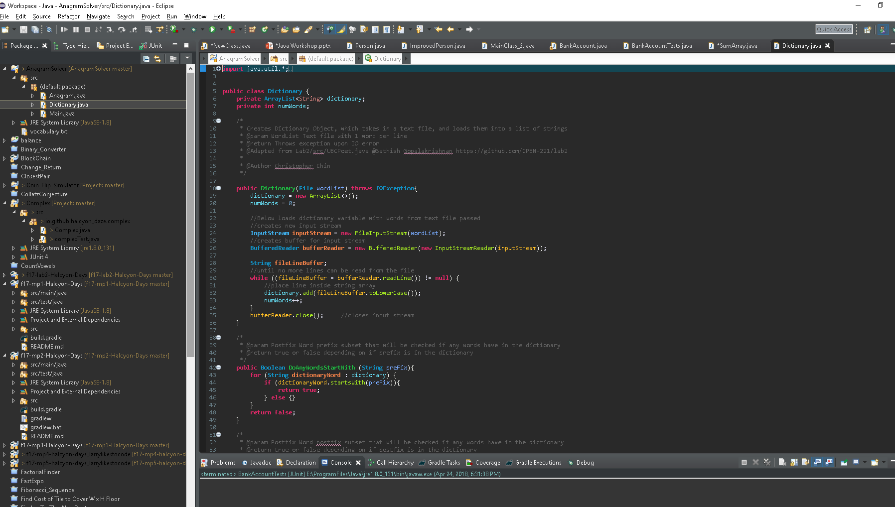

Slide 8
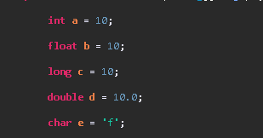

Java – Primitive types
Same as C for the most part
Integers
Floats
Long
Double
Char
Arrays
Additionally there’s support for Strings(capital S)
Note double vs single quotations

Slide 9
Java Operations
Same as C
+ - * / % & | | ++ -- += -= *= /=

Slide 10

Java Conditionals && Loops
Also the same!
<, <=, >, >=, ==, !=, &&, ||
If / Else / Else if
While
For
Additionally there’s a native Boolean type, which can be true or false

Slide 11
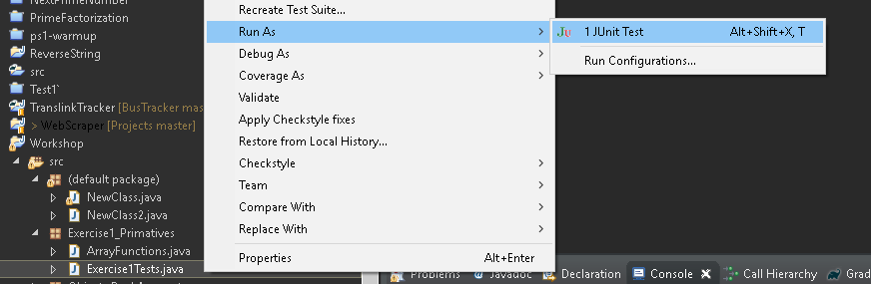
Lets just review what we know!
Open ArrayFunctions
Fill out the 3 empty functions
Try to pass the unit tests in Exercise1Tests

Slide 12
Objects
Start from thinking of a Struct + Methods unique to that struct

Slide 13


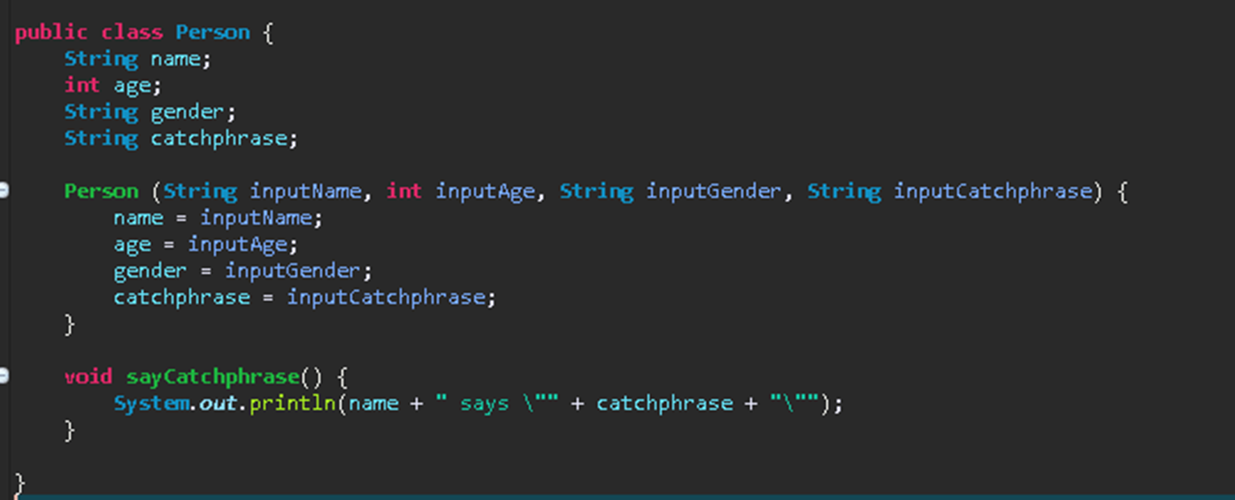
Classes vs Objects
Classes: Like the blueprint for an object | Objects: The instantiation of the class

Slide 14
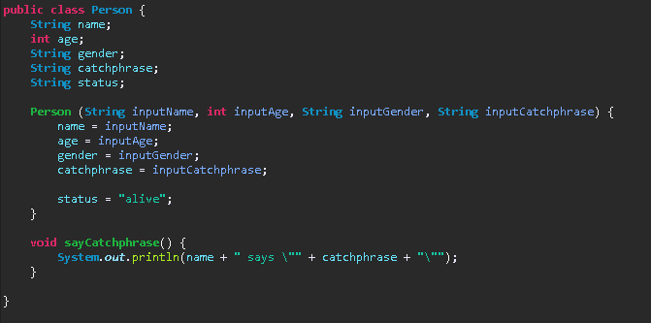
Class
Class name
Fields
Constructor
Method(s)

Slide 15
Declaring Object
You don’t need to free the memory used for objects, Java will automatically do that for you!
This variable reference is a pointer to the object
Person Batman = malloc(sizeof(Person));
Batman.name = “Batman”;
Batman.age = 26;
etc….

Slide 16

Calling Method on an object
Batman is implicitly taken in as an argument
In C it would be equivalent to:
sayCatchphrase(batman);

Slide 17
Lets try this!
Lets try making a simple class for a dog
Make fields for name, age, breed
Make a bark() method which prints out Dog name “ says bark!” (or “bork”)
Try Instantiating it, and running the bark method for the dog

Slide 18
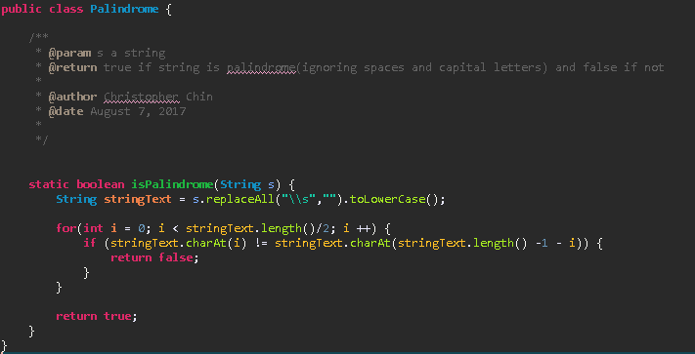
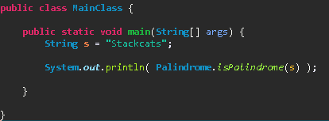
Static Methods
Unlike the methods for objects, these ones are not explicitly called on a single object but for the class itself
Would be similar to how functions are normally are in C

Slide 19
Collections
Lists – Indexed collection of objects
Set – Unordered collection of objects
Hashmap – unordered collection of objects accessed with key – values pairs

Slide 20
Lists
Object type provided in Java libraries
Like arrays, but Dynamically resizing!
Indexed collection of objects
There are several kinds, we’ll use the ArrayList
https://docs.oracle.com/javase/8/docs/api/java/util/ArrayList.html
Some important methods are: add, get, size, contains
Declare what it is in the list

Slide 21


Enhanced For loop(Foreach loop)
For each element(int here) I in list, do….
Lets you iterate through all elements in a collectable object
A little simpler to write

Slide 22
Lets try these out
Create a static function called similarList that takes 2 ArrayLists of Integers and returns a new ArrayList that only contains Integers in both lists
Create a static function called nameStartsWith that takes in an ArrayList of ImprovedPerson and some String c, and returns a new list that only contains ImprovedPerson with a name starting with the String c
Try to pass the tests in Exercise3Tests
For the starting with String c check, look at javdocs for strings
https://docs.oracle.com/javase/8/docs/api/java/lang/String.html

Slide 23


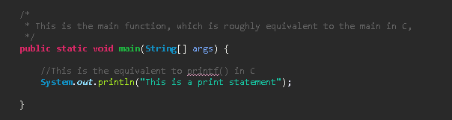
Public Keyword
Are implicitly public
The public keyword means that this field/method can be freely accessed by anyone
Conversely, the private keyword means that the field/method can only be accessed within the current class

Slide 24


Person
Person
Name
Age
Gender

Slide 25
Other keywords for fields
Static – For fields, associates value with a class
Final – This value cannot be changed
Typically used for constants

Slide 26
Next Exercise – Bank account
Design a Bank Account Object
Bank Accounts will need:
Fields for:
A name string of the user
A password string for the user
A current amount that they own
A list of transactions for that user(you wouldn’t need to input this as part of the constructor, just create a new list when you create the object)
A unique ID for each account, use a static integer to keep track of this, starting at 0
Methods for:
getAmount – input String password, returns the amount that a user owns, if they input in the right password and -1 if wrong password
getTransactions – input String password, returns the list of transactions that a user owns, if they input in the right password and return null if wrong password
getID – input string password, returns id, -1 if
makeDeposit – input an integer amount, and password, change the amount user owns and add the change to the transaction list, no change if wrong password
makeWithdrawal - input an integer amount, and password, change the amount user owns and add the change to the transaction list(negative because withdrawal) , no change if wrong password
checkPassword – input password String , return true if correct for this account, false if not, this will only be used in the next method, so you can make it private since it wont be called outside of this class, and won’t be checked
makeTransfer – transfer money FROM user1, the one being called on ,TO user2. Input another BankAccount object for user 2, password for user 1, password for user 2, and an amount, no change if wrong password for either user

Slide 27
Tips
You can make a main function in the bankaccount class to test with
Make sure that your methods match the names given so that my tests work!
When comparing Strings use .equals() not == !
Think about why you are using private fields here, and why its important to limit access inside your objects
Make sure to add to transactions List for transfers
What happens if you input 1 correct password, and 1 wrong password?
If you get stuck, look at past code, or ask for help
If you finish early, try expanding on your Bank Account Object,
For example, “What would you do if the user made a withdrawal that makes their balance go negative?” or “How would you structure a Bank Object around this BankAccount Object?”
Doing this encourages you to think past just fulfilling my unit tests, and think about actually designing an object for yourself and what would improve this

Slide 28

Final Exercise
Create a function that, when given an arbitrary positive integer, returns PI to that many digits

Slide 29

Challenges?
How to calculate PI?????
Return type????

Slide 30
Calculating PI
Pi has an infinite amount of digits, how can we calculate it?
We don’t actually need all of Pi, we just need a number of digits up to a point
Pi is usually calculated iteratively, as a sum of values
https://en.wikipedia.org/wiki/Chudnovsky_algorithm

Slide 31
Chudnovsky algorithm
1: 3.1415926535897342076684535915782983407622332609157065908941454
2: 3.1415926535897932384626433835873506884758663459963743156549057
3: 3.1415926535897932384626433832795028841971676788548462879127277
See a pattern?
We only need to calculate PI UP TO SOME POINT, as long as we can guarantee that all the digits up to that point are correct, then we can return the value
Each iteration of the algorithm gives around ~14 correct decimal points, so you only need to run it digitsRequired/(12 or 13ish) (+1 maybe for safety) times to get the decimals required

Slide 32
Return type
We found a way to calculate PI, we’re saved!
But wait, how do we return the value?
Doubles can only hold up to 15-17 decimal points
You could use String to hold all the decimal points but it’ll be hard to calculate with them

Slide 33
Big Decimal type
Search up “Big Decimal Java 8” for Java docs
Used for arbitrary number of decimal digit calculations
How does it work internally? Nobody cares! Just use it how its represented
Note that its an object, so DO NOT DO
Bigdecimal s + Bigdecimal t
Use the methods specified on the javdocs to operate with this type

Slide 34
Additionally
Bigdecimal objects do not have a method for getting the square root of them or their factorial
I already wrote functions for this in BigDecimalHelper, or you can write your own if you want a challenge ☺
Check against https://www.piday.org/million/ and the unit tests

Slide 35
Thank you for coming out today

